Slide 1
CIS400 – Principle of Social Media Mining
SOCIAL MEDIA Sentiment prediction with Amazon reviews
By: Song Wei Kong

Slide 2


Project Overview
To investigate the viability of cross-platform sentiment prediction models

Slide 3
The Data
100,000 fine food reviews from Amazon.com
Total words: 8345146
Average words per review: 83.451 words
Positive Reviews (rating >3): 77055
Negative Reviews (rating<4): 22945
Fields: Id, ProductId, UserId, ProfileName,
HelpfulnessNumerator, HelpfulnessDenominator, Score, Sentiment, Summary, Text

Slide 4
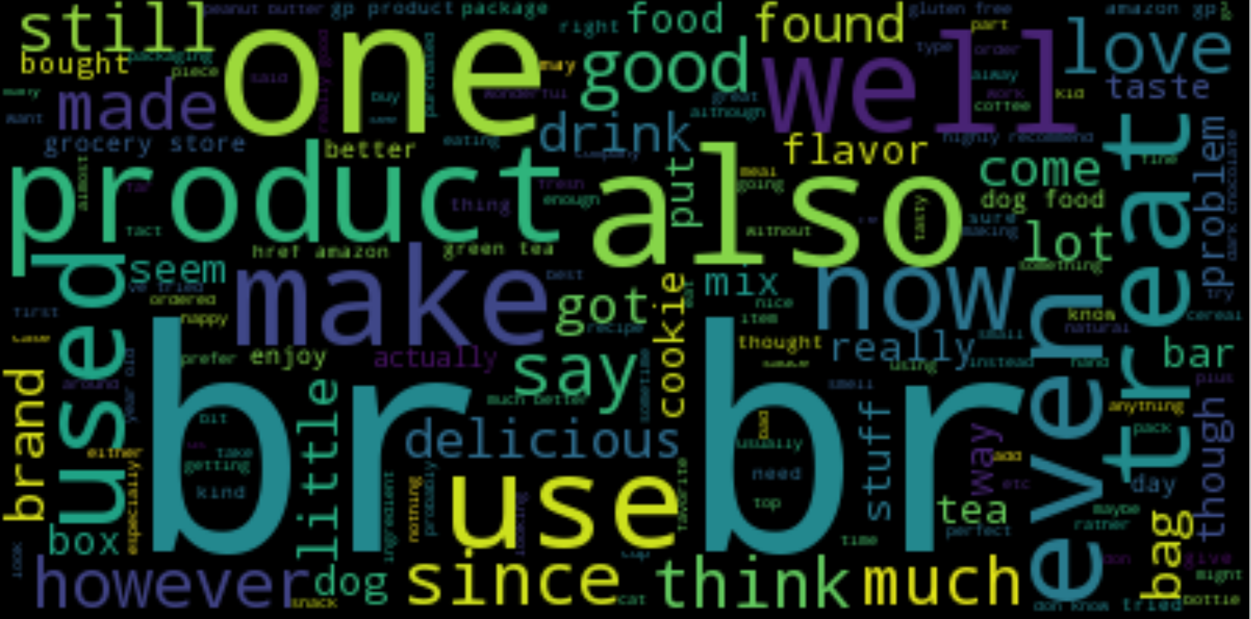
Word Cloud

Slide 5
Data Cleaning & Preprocessing
Removed punctuation
Removed HTML elements & Links
Removed stop words
Standardized to lower case
Data binarization

Slide 6
Model
Prediction for Amazon Reviews
Model | Accuracy
Naïve Bayes ** | 0.775
Random Forest Classifier | 0.855
Support Vector Machine (Linear) | 0.88
Prediction for 51 labelled tweets about food
Model | Accuracy
Naïve Bayes ** | 0.569
Random Forest Classifier | 0.62
Support Vector Machine (Linear) | 0.58-0.65
** n=20000

Slide 7
WHY THE HUGE DIFFERENCES?
Character limit: 140 chars vs unlimited
Context of data
More data points != better results

Slide 8
Challenges
Difficult to find negative food review samples on social media
Huge amount of data on limited processing power

Slide 9
Thank you!

